Slide 1
Capstone Project 2
Rossman Retail Sales Prediction (Regression) Team Members Mohammad Irfan Vishal Singh Dileep Singh
Md. Inamul Haroon

Slide 2
Points for Discussions
Introduction
Problem Statement
Data Summary
Data Wrangling
Data visualization
Analysis based on Store type
Analysis based on Assortment levels
Analysis based on store open or closed on State Holiday
Bar Plot of various categorical variable the basis of Sales (Bivariate)
Assortment on the basis of Sales (Bivariate)
Scatter plot of Sales and competition distance on the basis of Store Type (Multivariate)
Plot of Sales on the basis of Dates (Bivariate)
Stacked Bar Plot of store type and promo data on the basis of sales (Multivariate)
Average sales of each store type on applying different Assortment strategies.
Multiple Line plot Showing Monthly Sales over years.(Multivariate)
Relation between Store Type and state Holiday on the basis of Sales.(Multivariate)
Relation between Customers and Store Type on the basis of Sales.(Multivariate)
3. Price density curve
4. Data Analysis
1. Heat Map
2. Bar Plot
3. Pie Chart
4. Violin Plot
5. Scatter Plot
5. Conclusion

Slide 3
Continued…
14. Stacked bar plot showing total sales of each month of each year.
15. Correlation Heat map
16. Pair Plot
Hypothesis testing
Features Engineering
ML Model implantation
Which ML model is best?
Predicted vs Original data
Conclusion.

Slide 4
Introduction
Rossman operates over 3,000 drug stores in 7 European countries. Currently, Rossman store managers are tasked with predicting their daily sales for up to six weeks in advance. Store sales are influenced by many factors, including promotions, competition, school and state holidays, seasonality, and locality. With thousands of individual managers predicting sales based on their unique circumstances, the accuracy of results can be quite varied.
You are provided with historical sales data for 1,115 Rossman stores. The task is to forecast the "Sales" column for the test set.

Slide 5
Problem Statement
Rossman store managers are tasked with predicting their daily sales for up to six weeks in advance. Store sales are influenced by many factors, including promotions, competition, school and state holidays, seasonality, and locality. With thousands of individual managers predicting sales based on their unique circumstances, the accuracy of results can be quite varied.

Slide 6
Data Summary
The given dataset is a dataset from Rossman industry who operates over 3,000 drug stores in 7 European countries, and we have to analyze the sales of the stores and the factors affecting the sales. In the given dataset, it has 1017209 rows and 18 column. And there are some missing values, and there is no duplicate values in the dataset.
There are two datasets we are dealing in this project:
sales_data : It contains all the information regarding store sales, Day of Week, Date of sales, number of customers, stores is open or closed, stores are running promo or not, school holiday or not , and state holiday or not.
store_data: It contains all the information regarding store type, Assortment, Competition distance, Competition open since month, Promo 2 Since Week, Competition Open Since Year, Promo 2, Promo 2 Since Year, Promo Interval.

Slide 7
Data Summary
Store _data
Store (unique id)
Store type (a,b,c,d)
Assortment (a,b,c)
Competition Distance
Competition Open Since Month
Competition Open Since Year
Promo 2 (1,0)
Promo 2 Since week
Promo 2 Since Year
Promo Interval
Sales_data
Store(unique id)
Date
Day of week
Open(1,0)
Sales
Promo(1,0)
School Holiday(1,0)
State Holiday(1,0)
Customers

Slide 8
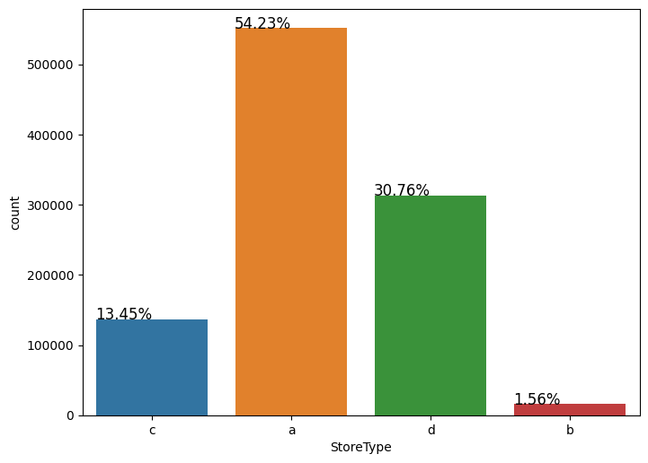
Analysis based on Store Type
The maximum number of stores are of Type ‘a’ and Type ‘d’.
The minimum number of store are of Type ‘c’ and Type ‘b’

Slide 9
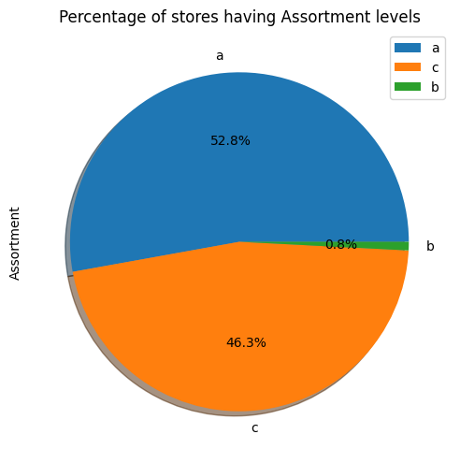
Analysis based on Assortment Levels
In the given dataset:
52.8 % stores have a:basic type assortment strategy
46.3 % stores have c:Extented type assortment strategy
0.8 % stores have b:Extra type assortment strategy. Here, we can see that maximum number of stores have basic or Extended type assortment strategy

Slide 10
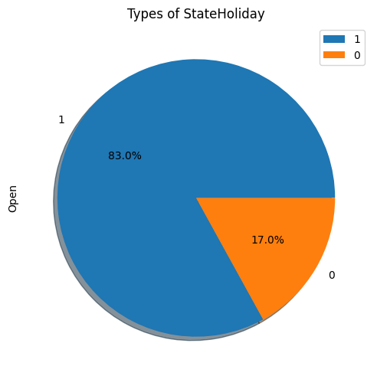
Percentage of Stores open or closed on State Holiday
The pie chart depicts that 83 % of stores are open and operating while 17 % of stores remain closed due to some state holiday or school holiday or some stores in the dataset were temporarily closed for refurbishment.

Slide 11
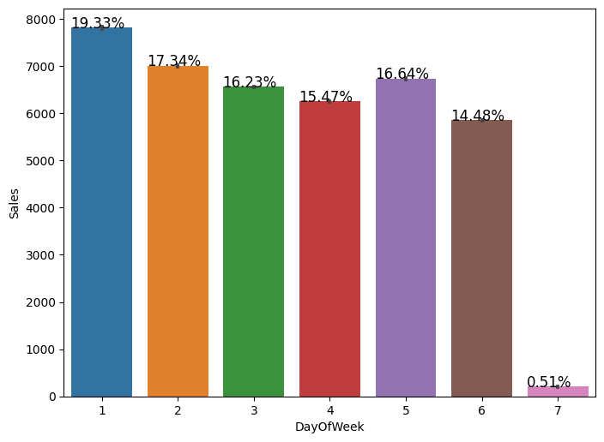
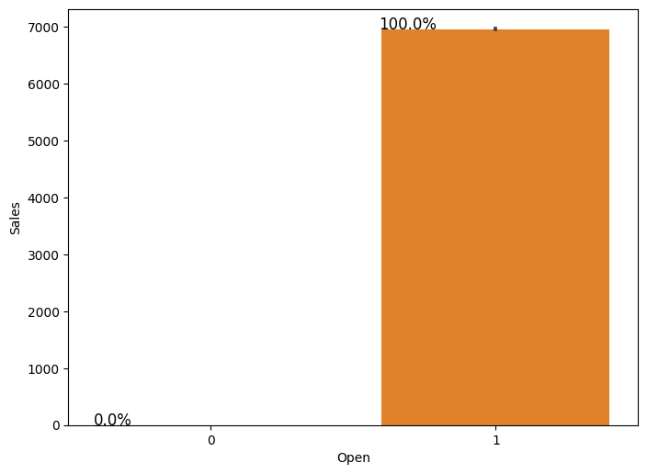
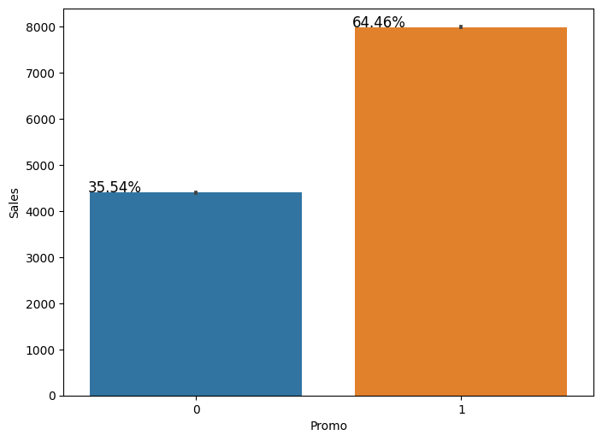
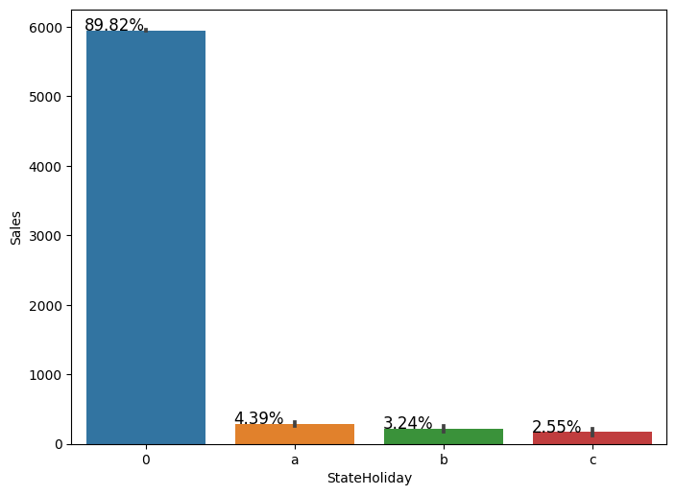
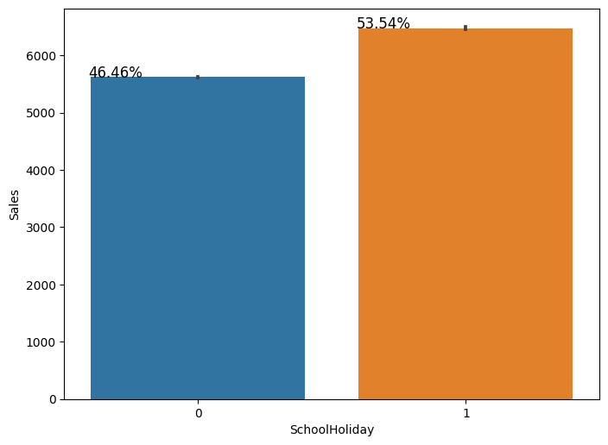
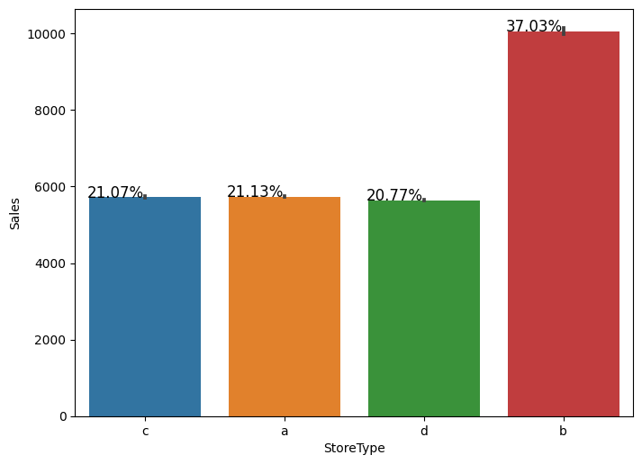
Bar Plots between Each Categorical Variable and Sales (Bivariate)

Slide 12
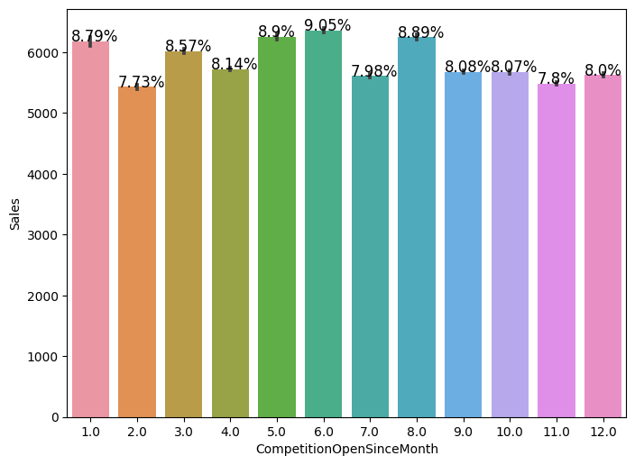
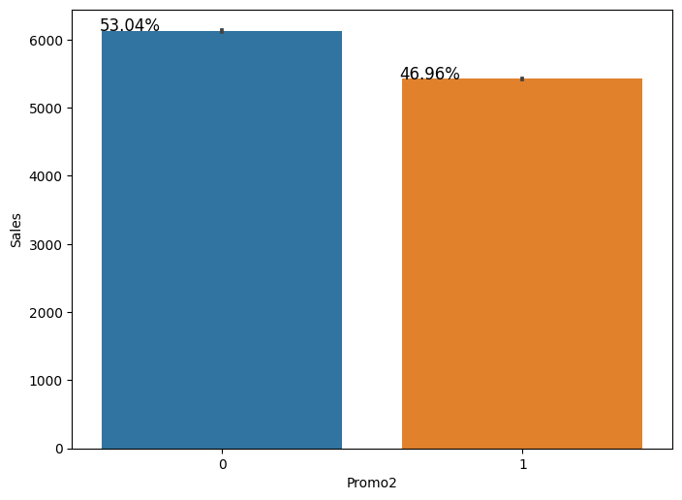
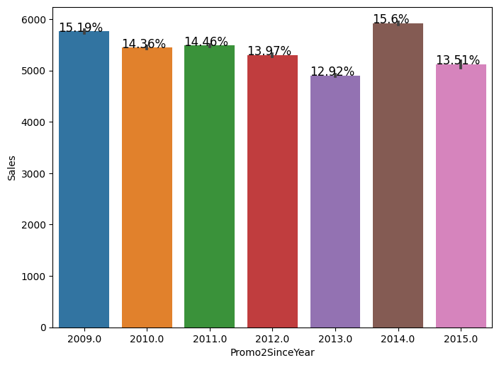
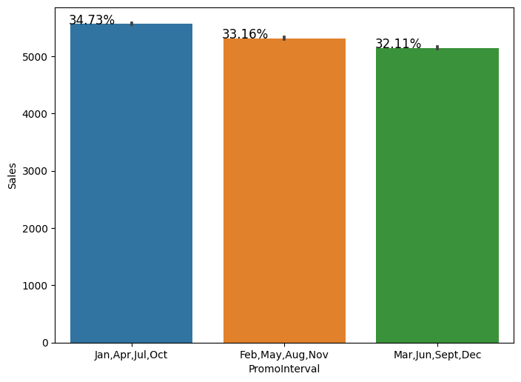

Slide 13
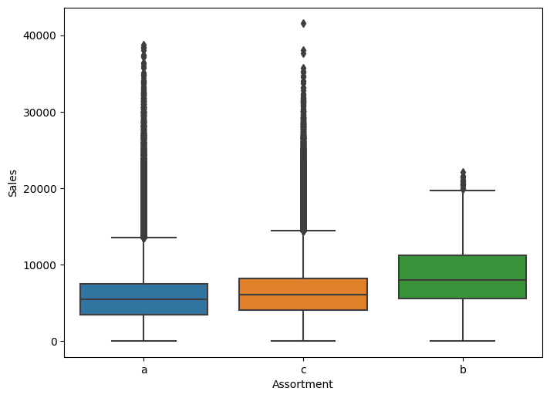
Box Plot between Sales and Assortment Levels (Bivariate)
The median sales is highest in b type assortment.
The highest sale is recorded in c type assortment.
The maximum number of sales of various types of assortment levels lie below 10000 sales. As we can also see that the maximum number of outliers are present in ‘a’ and ’c’ type assortment strategies sales.

Slide 14
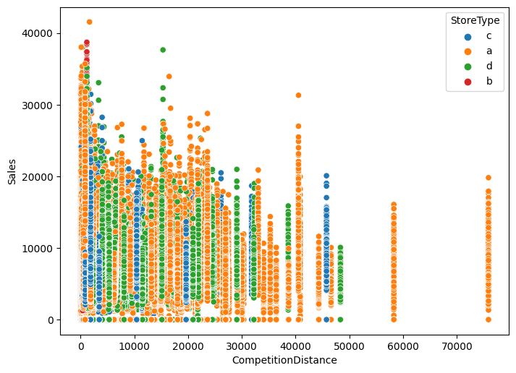
Scatter Plot between Sales and Competition Distance Considering Store Type
Here, we can see that when competition distances are less means when stores are closer to each other than sales are maximized. So, if there are lot of stores clustered together in a specific region, the sales will be high.

Slide 15
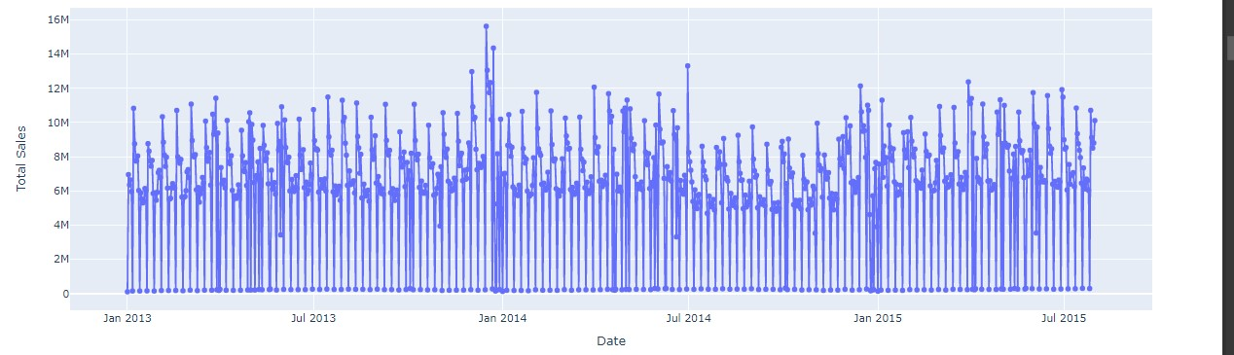
Line Plot of Sales corresponding to Date (Bivariate)
Here, we can see that the highest sale is recorded on December 16, 2013 (i.e. 15.62 million). Whereas, most of the sales are below 300K.

Slide 16
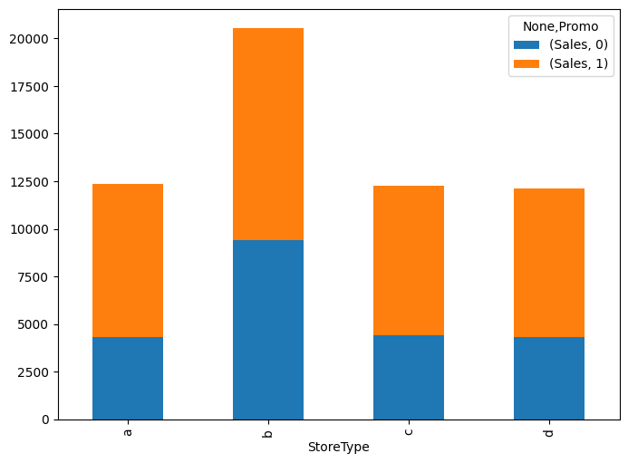
Stacked Bar Plot between Store Type and Sales considering the Sales (Multivariate)
From the stacked bar plot, it is clear that there is very high impact of promo on store type a , c and d. The stores which are running promo have recorded high sales as compared to the stores that are not running promo except store type b because in b- type stores, there is no much increment in sales as compared to other stores.

Slide 17
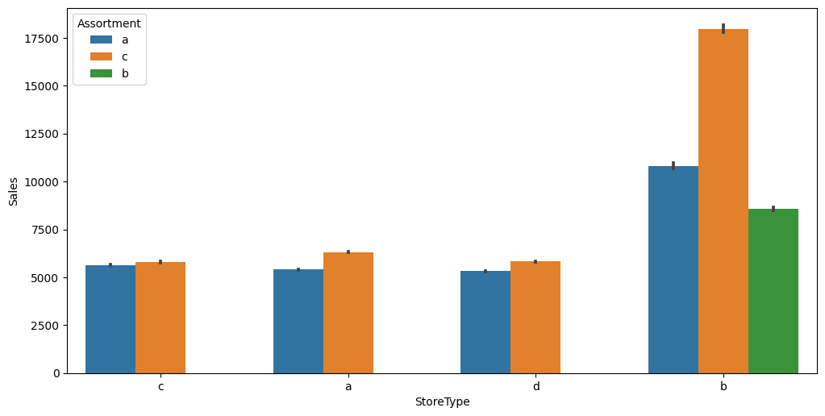
Average Sales of Each Store Type based on Different Assortment Strategies
The store type a, c, and d follow assortment strategies a and c while store type b follows assortment strategies a , b , c.
The stores that are following c assortment strategy have higher sales as compared to other assortment strategies.

Slide 18
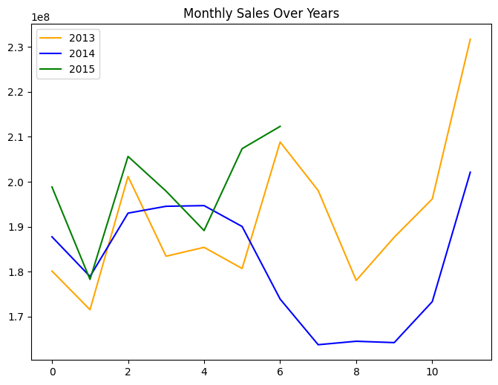
Multiple Line Plots of Sales over the Year 2013, 2014, 2015
If we compare the sales of 2013 with 2014, there is a huge randomness of sales in the year 2013 and follows a V-shaped recovery (a V-shaped recovery is characterized by a quick and sustained recovery in measures of economic performance after a sharp economic decline) while sales in 2014 varies like sinusoidal wave.
From the line plot, it is clear that sales are increasing drastically in the month of December of every year.

Slide 19
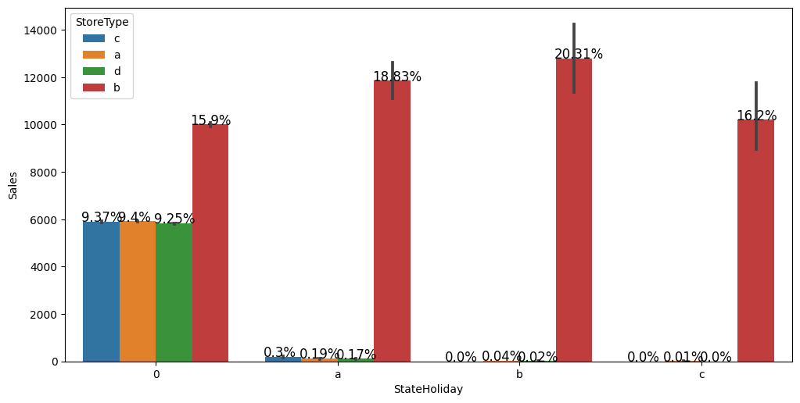
Bar Plot between State Holiday and Sales on the basis of Store Type .
Store type 'b' is having maximum sales whether it is state holiday or not. It means that this type of store remain open on state holidays.
On the other hand, store types a, c, and d are doing around negligible sales on State holidays and around 10 % (each) sales on not having state holidays.

Slide 20
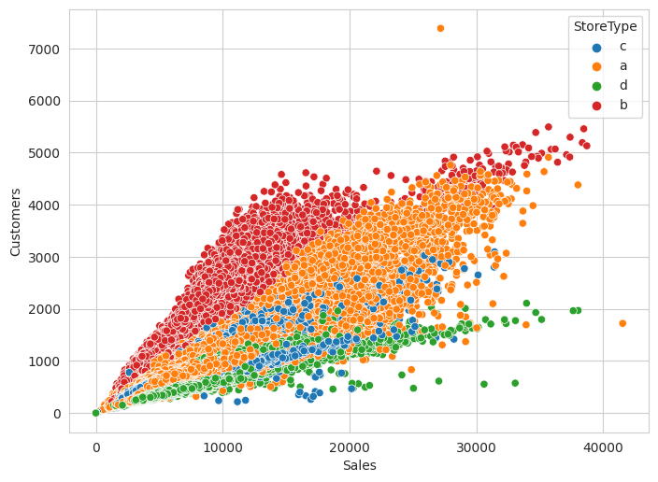
Relation between Customers and Sales on the basis of Store Type.
In store type b, at very low sales the customers are higher it means that customers are purchasing low price drugs more.
In store type a, sales and customer are increasing in equal proportion.
In store type c, at very high sales the customers are lower. It depicts that customers are purchasing high price drugs more.
In store type d, at very high sales the customers are minimum it means that customers are purchasing high price drugs more as compared to type c store.

Slide 21
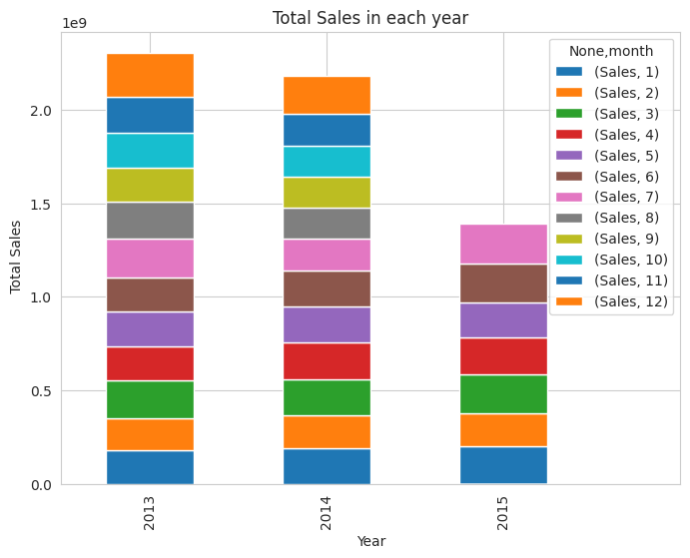
Stacked Bar plot showing Total Sales of Each Month in Each Year.
In the year 2013, the total sales are maximum in February, July and December
In the year 2014, total sales are almost same in all months except December because in December month the sales are maximum.
In 2015, we have sales record for only 7 months, and in December the sales are maximum.

Slide 22
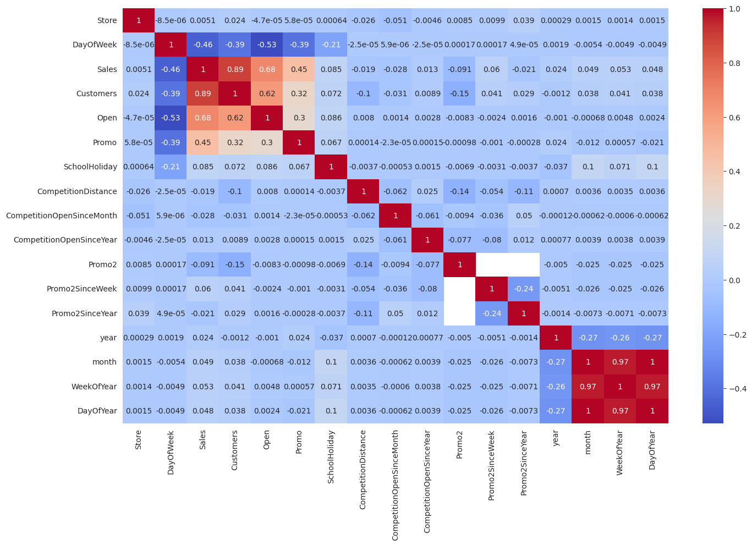
Correlation Heat map

Slide 23
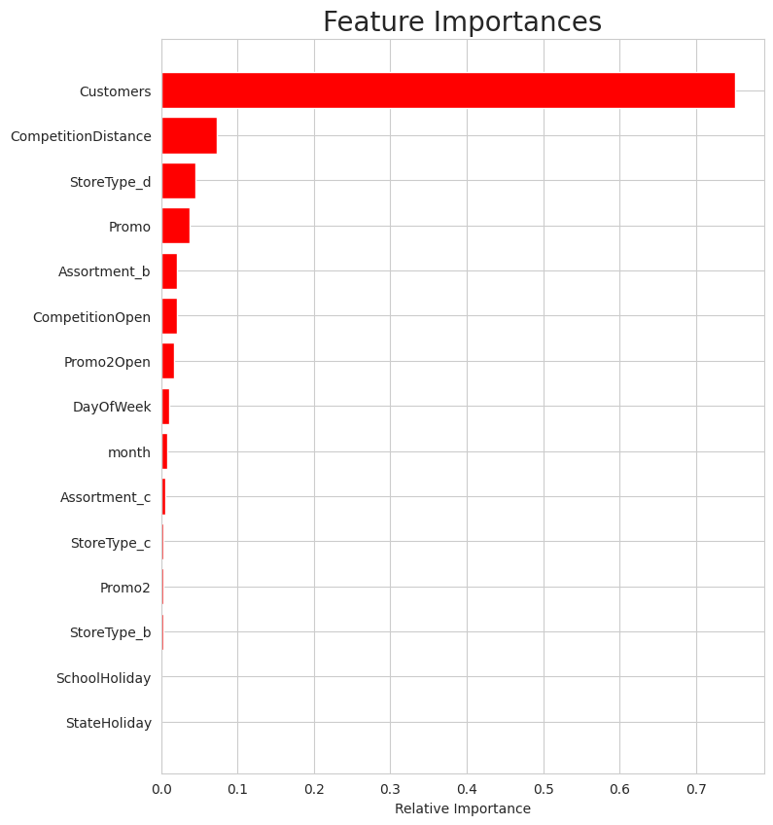
Feature Importance
Here we have shown which feature have high impact on sales.
Her

Slide 24
ML model implementation
1- Linear regression (r2_score--> 0.7900)
Linear regression using Cross- Validation & Hyperparameter Tuning (r2_score→ .817, 0.815, 0.813)
2- Decision Tree Regressor (r2_score→ 0.872)
Decision Tree Regressor using Cross Validation & Hyperparameter Tuning (r2_score→ 0..899, 0.920, 0.932 )
3- Random Forest Regressor (r2_score→ 0.9378)
4- Lasso and Ridge Regression (L1 and L2 Regularization) (lasso- 0.1477, Ridge- 0.7899)
Lasso using Cross Validation & Hyperparameter Tuning (r2_score→ 0.819)
Elastic net regression – (r2_score→ 0.09118)

Slide 25
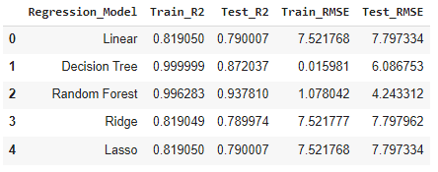
Evaluation Metrics for Different ML Models
From the above metric table, it is clear that the Random Forest Regressor is performing well on the given dataset with an accuracy of 93.7% followed by Decison Tree Regressor with accuracy of 87.2%. So, we are choosing Random Forest Regressor for best prediction.

Slide 26
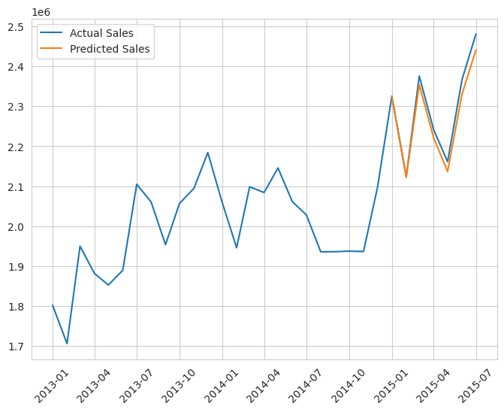
Predicted Last 6 Month Sales
Here, we have predicted the last 6 months (i.e. from 2015-01 to 2015-07) sales of Rossman stores using Random forest regressor.

Slide 27
Conclusions
About Assortment:
52.8 % stores have assortment type "a"(i.e. basic type)
46.3 % stores have assortment type "c" (i.e. Extended type)
0.8% stores have assortment type "b" (i.e. Extra type)
About Store Type:
54.23% stores are "a" Store Type
30.76% stores are "d" Store Type
13.45% stores are "c" Store Type
1.56% stores are "b" Store Type
83% stores are open, and 17% stores are closed due to State Holiday or School Holiday.
Sales are maximum on Monday and least on Sunday
Sales are quite high (nearly two times) when the promo is running
Sales are very low when there is a state holiday
Sales are high on school holiday (not state holiday)

Slide 28
Conclusion Continued….
The maximum sales are happening in store type b
There is no clear relation between the sales and Competition Open Since Month
There is no much difference in sales when promo2 (promo in consecutive months) is running.
Sales are higher when the competition distance is low. So, if similar stores are located together at minimal distances, the sales will be high.
The highest sale is on December 16 2013 which is 15.62 million while most of sales are below 300K during other dates.
The highest sales is recorded in store type b. The sales during promo is higher than sales without promo in all store types.
Sales is highest in store type "b", and among the assortment strategies, the highest sales are recorded for "c" type assortment.
Sales in the year is 2015 is high (till the given month). However, the sales have drastically decreased for in year 2014.

Slide 29
Conclusion Continued….
The sales are highest for store type "b". Specially, on state holiday, the sales are tremendously high because they are open even on state holiday.
In 2013, the total sales are maximum in February, July, and December
In 2014, total sales are almost same in all months except December because in December the sales are maximum.
In 2015, we have sales for only 7 months, and in December the sales are maximum.
The features Promo, Open, Customers are positively correlated with sales.
Sales, Customer, Open, and Promo are negatively correlated with Day of week
Open and Promo are positively correlated with Customers.
Sales and customers are positively correlated with Open while Day of Week is negatively correlated with Open.
Day of week is negatively correlated with Promo.
Random Forest Regressor is giving the best result with the accuracy of 93.78% followed by Decison Tree Regressor with accuracy of 87%.

Slide 30
THANK YOU

